Slide 1
Ease →
Employee Navigator Migration Walkthrough

Slide 2
CRC Benefits Migration Assistance
resources
support
Ease → EN Checklist
Migration FAQs
Adding a Company
Enabling CRC Benefits in EN
How to Video
Help auditing warning/errors in Ease
Assist updating Employee Navigator
Discuss strategy surrounding timing of migration
Questions, contact: benefits.benadmin@crcgroup.com

Slide 3
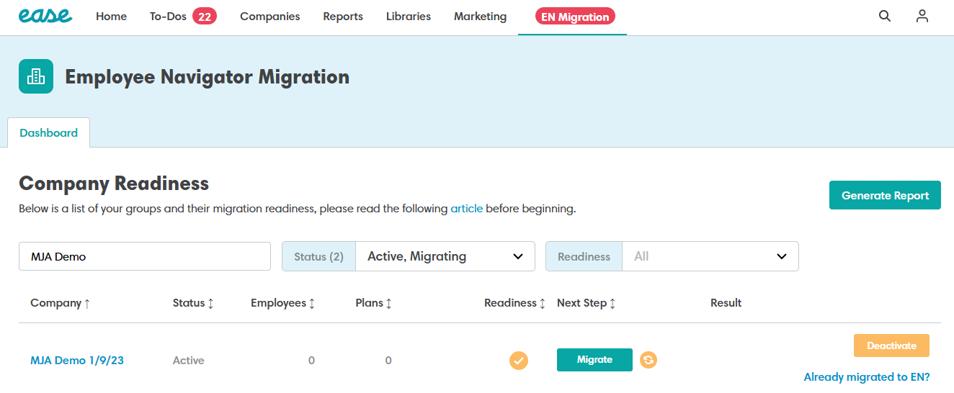
Open the Migration Dashboard in Ease
Accessing the Migration Dashboard
Users select the EN Migration option in Ease to view all groups and their migration status in one place.
Centralized Group Status
Dashboard displays readiness, employee counts, plan counts, and next-step indicators for groups.

Slide 4
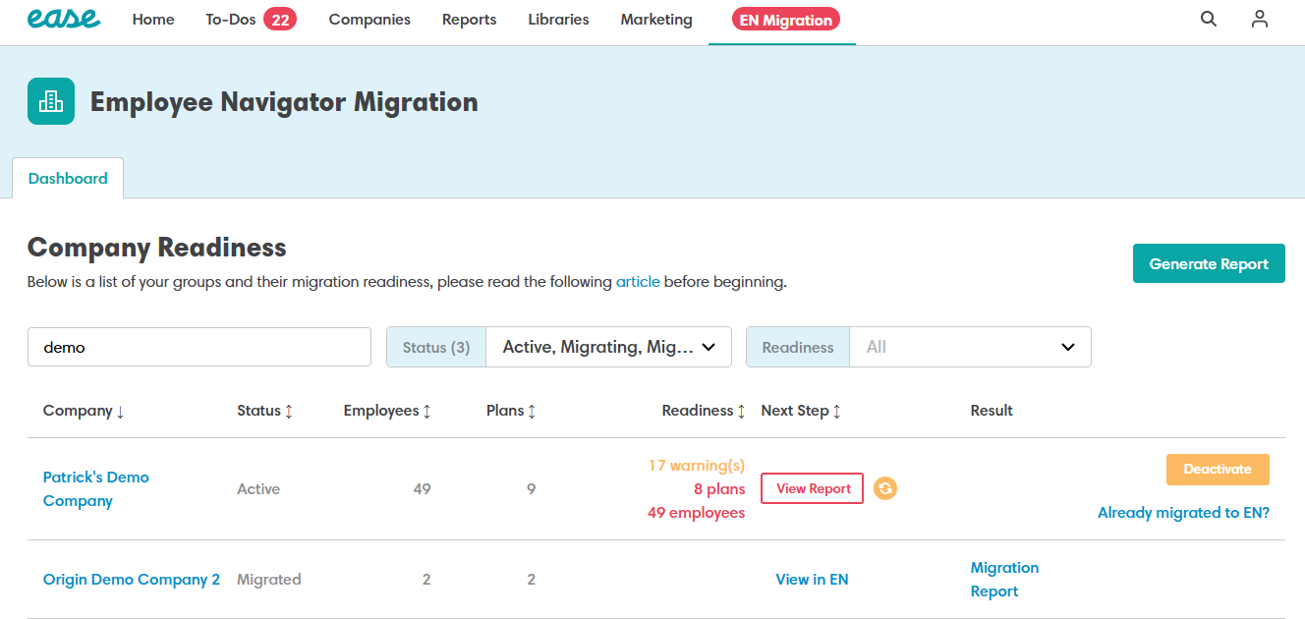
Refresh Readiness
+ Review Status
Refresh Function Purpose
The Refresh feature updates group data to reflect recent changes and ensures compliance with migration rules.
Readiness Indicators
Readiness status shows errors, warnings, or readiness to guide migration decisions and preparation.
Importance of Review
Groups can be migrated with warnings but not with errors.

Slide 5
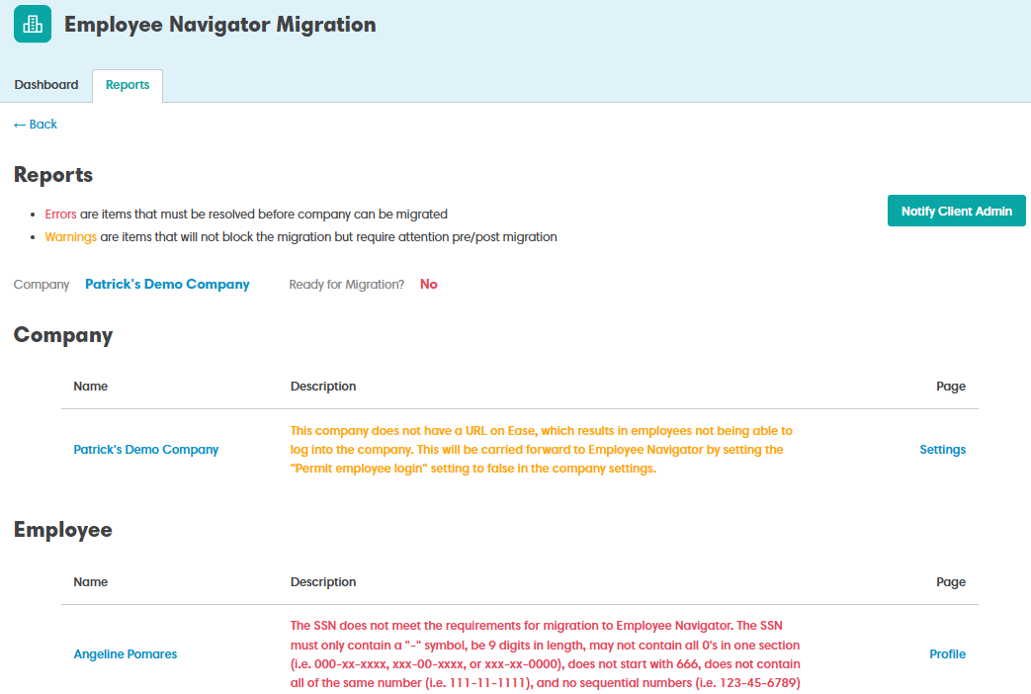
View the Migration Readiness Report
Detailed Diagnostic Insight
The report identifies specific issues affecting migration at both company and employee levels for precise troubleshooting.
Clear Error Identification
Errors are clearly highlighted with explanations, helping users understand and resolve critical blocking issues effectively.
Guidance on Warnings
Warnings provide helpful guidance on items that might need attention but do not prevent migration progress.
Facilitates Smooth Migration
The report removes guesswork, enabling targeted corrective actions that

Slide 6
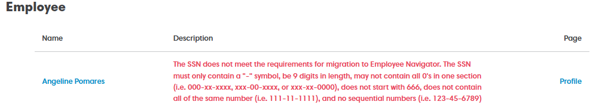
Resolve Blocking Mirrors Before Migration
Identify Blocking Errors
Blocking errors like missing URLs and invalid SSNs must be identified before migration can proceed.
Use Readiness Report
The readiness report provides direct links to fix errors efficiently and accurately.
Confirm and Refresh Status
After corrections, confirm fixes are saved and refresh status to verify errors are resolved.

Slide 7
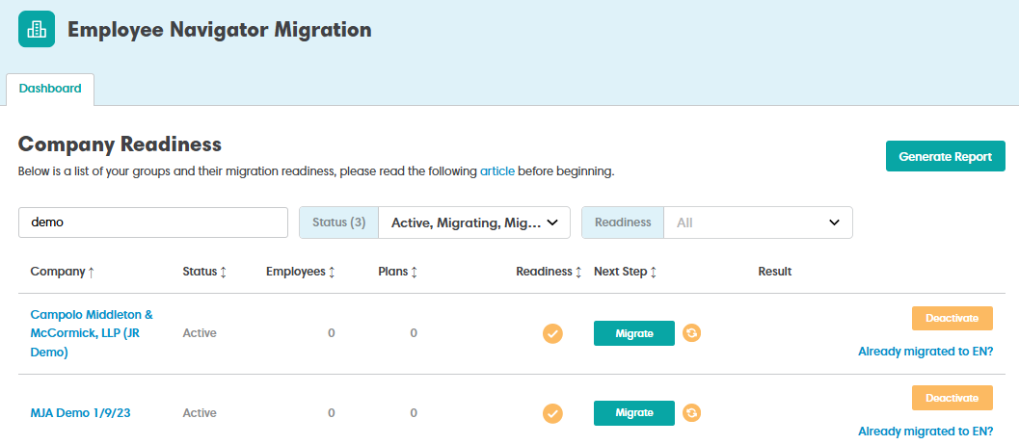
Click Migrate to
Start the Process
Initiate Migration
Clicking Migrate starts the formal data transfer from Ease to Employee Navigator after all errors are fixed.
Confirm Readiness
Ensure no critical updates occur during migration to avoid losing changes or data inconsistencies.
Migration Process Importance
Clicking Migrate confirms that all preparation steps are complete

Slide 8
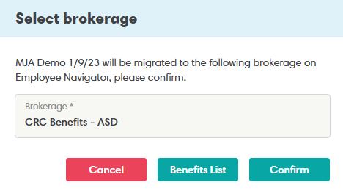
Confirm Brokerage Destination
Brokerage Confirmation Importance
Confirming the correct brokerage ensures proper administrative and support access after migration.
User Verification Step
Users must carefully verify the brokerage name to avoid errors in group association.

Slide 9
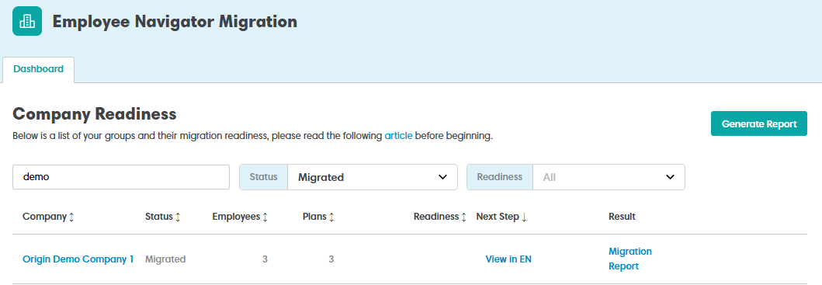
Migration In Progress and Completion
Click on the Migration Report
This tool will note items migrated and any items that need to be manually updated in Employee Navigator

Slide 10
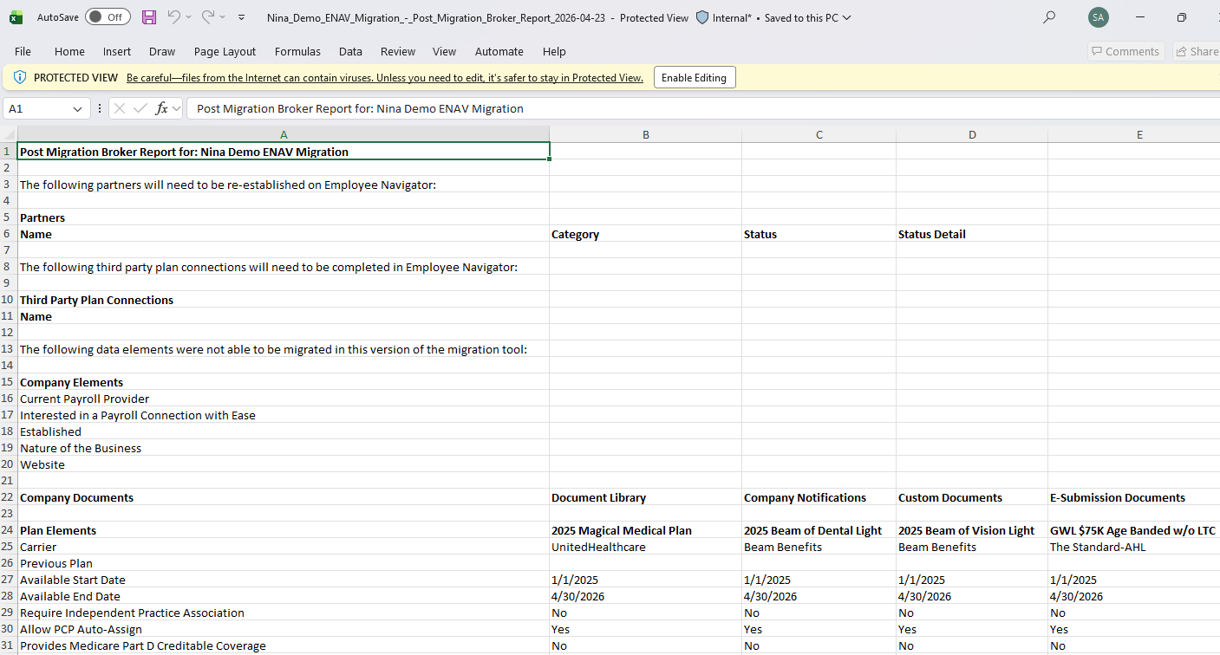
Migration Report
Real-time Migration Updates
The dashboard displays live status changes during migration, keeping users informed of ongoing data transfers.
Migration Status Change
Status updates from “Migrating” to “Migrated” mark the completion of the migration process.
Post-Migration Actions
Links become accessible to view groups and reports, facilitating further management after migration. Ease will be in read only. Broker will ensure integrations disconnected

Slide 11
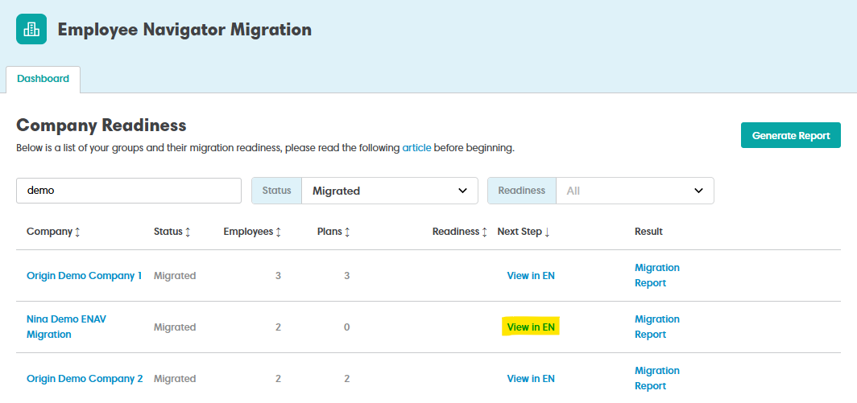
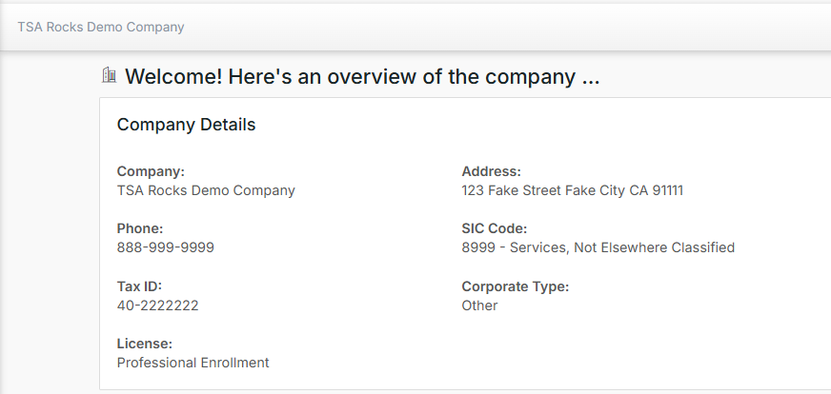
View in
Employee Navigator
Group is now read only in Ease and viewable in EN
The broker can now view and edit the group as needed in Employee Navigator

Slide 12

Granting CRC Benefits Broker License Access
TO GIVE THE LICENSEE USER ACCESS TO BUILD/MANAGE GROUPS:
Go to the Licensee Account > Users
Click the edit pencil next to that user
Click Open Access
Assign them to the appropriate team (Everything default team) or specific company
TO GIVE THE LICENSEE USER ACCESS TO BUILD/MANAGE GROUPS:
TO ADD A LICENSEE USER SO THEY CAN BUILD GROUPS, START AT THE LICENSEE LEVEL:
Go to the Licensee Home Page
Select the Users tab
Click Add User
Complete the required profile fields:
Email address - Benefits.Benadmin@crcgroup.com
First name - Ben Admin
Last name - Team
Leave the user marked Active
Save the user profile
Manage Login - Change 2FA to Email (Required)
Use Send Registration from the manage login page if they need to register

Slide 13

Questions?
Contact CRC Benefits’ Online Enrollment team: benefits.benadmin@crcgroup.com

